Slide 1
Physics 124: Lecture 6
Projects

Slide 2
The Rubric, Once Again
Sense some real-world quantity
input: analog or digital
sensor or user input (switches, keypad)
Process the information
code in software
analog processing could play a role
Do something externally
in reaction to the input and processing
LCD display at simple end; controlled motion on the other

Slide 3
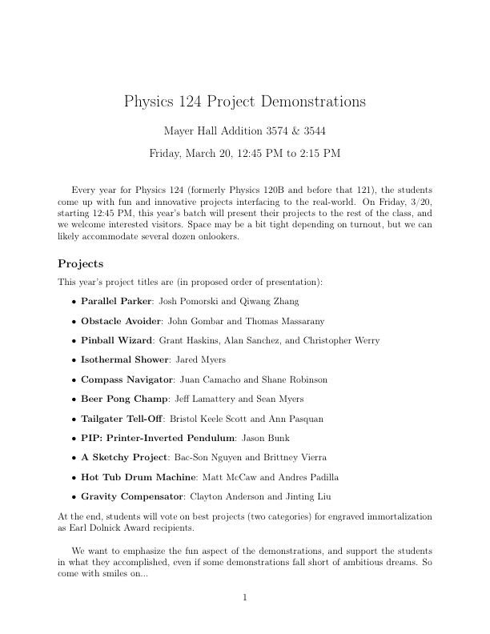

Slide 4
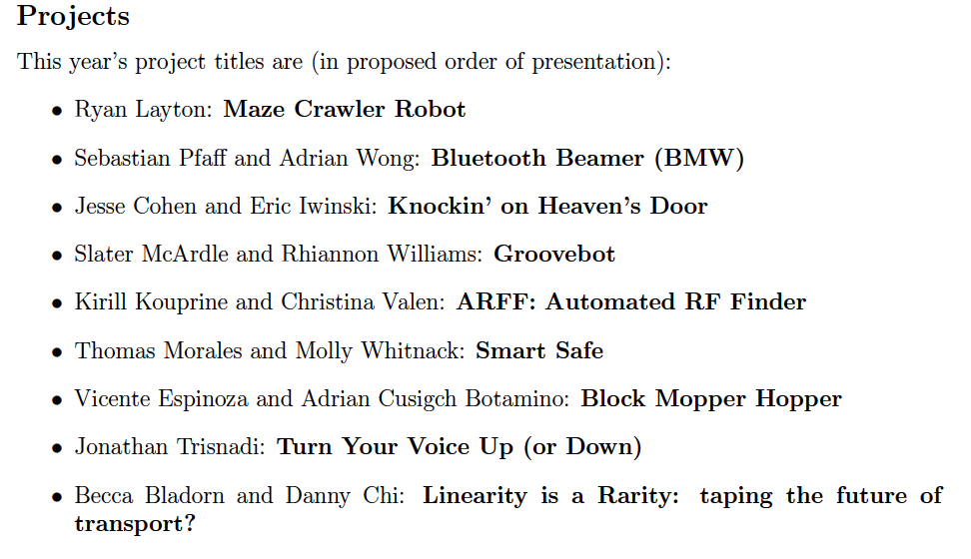
2014 projects

Slide 5
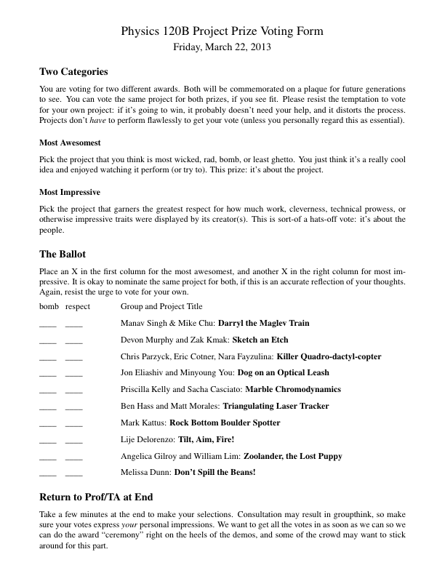
Example (Student) Voting Form

Slide 6
Getting Ready
Find a partner
not committed to stay in initial group
Bat around project ideas
useful to have several in mind, if you can
could be based around a sensor, a technology, an action
we’ll look at a variety of examples from the past
Create a written, detailed proposal so that
we can evaluate the feasibility and level-appropriateness of the project
we can suggest expansions or reductions, easier alternatives, or come up with fallback de-scope options
you think through what the project needs in advance

Slide 7
Proposal Contents
Motivation and overall concept
the big picture: why and what
Functional definition
more detailed description of what the thing should do, and how it will react to all foreseeable operating states/stimuli
when you code the behavior, it is this section that defines what you are trying to do
Sensors
what input devices are you going to use
how do they behave and how are they to be used

Slide 8
Proposal, Continued
Mechanical Considerations
this is where things can get janky
it’s easy to wave this off as not a big issue, but can be the hardest part in getting the project to work well
how is the device supported?
how are elements attached?
what custom pieces will have to be made?
out of what material?
do we have the necessary materials on hand?
Electrical Considerations
what elements are needed, and how are they hooked up?
analog electronics needs/functions
circuit diagram
wiring (mechanical aspect: what wires, connectors, etc.)

Slide 9
Proposal, continued
Interface
what (presumably) Arduino unit?
what pins/inputs/outputs are needed?
what communications?
Software
how will the programming go?
what are the tricky parts?
what libraries might you use?
what new capabilities do you need to explore?
Testing
how easy is it to test performance in the lab?
Safety
flame, sharp objects, high velocity, high voltage, chemicals, etc.
how will you manage safety if these things are involved?

Slide 10
Proposal, continued
Parts and Reusability
what parts do you need?
what parts are on hand?
what new parts are needed?
which parts will be consumed vs. reusable by future projects?
are there long lead-time items on the list?
Expansion Options
what enhancements might you consider if things are going very well?
De-scope Options
what ambitions might you shed if things are tough
fallback positions defining minimum capability

Slide 11
Proposal, continued
What you will turn in
a brief section of the proposal explaining the contents of the report you expect to hand in at the end
a well-written proposal can serve as 70% of the final report
Why all the work?
proposals are a key part of science
a spear with which to chase down Mammoths (NSF, NASA, DoE)
proposals focus the mind to clearly think through a project
the proposal becomes a template or guide to your work
helps organize/prioritize actions
gives a chance to sync up to class expectations

Slide 12
A Template Proposal
For the fourth-week lab, we will switch gears a bit and make a mini-project following a proposal-form write-up
light-tracker with optical collision sensor/interrupt
you get a good example of what a proposal contains
you learn more about what a project takes to accomplish, on a smaller scale
you are turned loose to apply the skills acquired in first few weeks of the course
extra time to turn this in; proposal comes first

Slide 13
Due Dates
Proposals are due by the end of 5th week; Feb. 5
Gives us weekend to read and offer feedback next week
You will have about two weeks to work on both the project proposal and the mini-project
Don’t worry about a complete report for the mini-project
usual functionality check by TA/prof
turn in code
paragraph about contributions
Mini-project due Feb. 9/10
Will stick midterm sometime after these due dates

Slide 14
Equipment Needs
We have an amazing array of useful junk/parts
start here; much of it is in workshop, but look in cabinets and on shelves in main lab rooms
Stuff we don’t have, you either purchase yourself, or UCSD buys
do you intend to keep it afterwards?
will it be usable/useful in future student projects?
is it reasonably-priced?

Slide 15
Work Shop
You have access to a workshop with power tools
dangerous: rule is someone else must be in room when you are operating the band-saw, drill-press, sander, hand drill or anything else that could be dangerous
Keep it clean!
restock drill index after you are done
put away tools when you are finished
sweep up chips/dust/scraps

Slide 16
List of previously used devices/techniques
Compiled by Fred Driscoll; • represent instances in past several years; w represents Arduino-based
Digital Out
many LEDs •••ww
Relay/Valve/Solenoid •••
AC power control (relay) ••••
Stepper motor ••wwwwww
Digital In
pushbutton/keypad •••••www
light break (photogate) •••w
magnetic sensor (present or not) •
encoder w
IR proximity ••wwwwwww
Passive IR (thermal) •

Slide 17
Components, continued
Analog In
potentiometer •w
joystick ••
phototransistor •••wwww
thermistor or RTD •w
flex strip •••
accelerometer •wwwww
gyro or compass ww
weight •
RF input power w
audio bands ••••
coherent detection •
audio input (yes in past, no records) www
audio output (yes in past, no records) w
piezo vibration sensor ww
Hall sensor (magnetic) w
40 kHz ultrasonic (raw) ••w

Slide 18
Components, continued
Analog Out (PWM)
LED brightness control ••••w
DC motor speed (drive; optoisolated) •••••••••wwwwwwwwwww
motor position (servo) •••••••••••••wwwwwwwwwwwwwwww
buzz w
audio output ww
phone line (dial out) •w
signal conditioning (yes in past, no records) wwww
electromagnets/coils (yes in past, no records) ww
High current/power (yes in past, no records) ww
ESC/brushless DC (no prior records) w

Slide 19
Components/techniques, continued
Serial I/O
MIDI •••w
I²C protocol
Temperature •••••
blood pressure •
PC input ••
Camera •ww
Sound synthesizer •
USB
RF communications (yes in past, no records) ww
Parallel I/O
Liquid Crystal Display (LCD) •••wwwww
DAC •

Slide 20
Components/techniques, continued
Timing
RPM ••
echo-distance ••wwwwww
valve time •••
data logging •
Time Slicing
7-segment display •
keypad ••
touch-sensitive caps ••
remotes ••
High Current or Voltage
kill switches ww
power transistors ww
opto-isolators ww

Slide 21
Some Time Touring Old Projects
http://www.physics.ucsd.edu/~tmurphy/phys124/projects/projects.html
covers Arduino revolution, starting Winter 2013
http://nnp.ucsd.edu/Phy120B/tour_121/
before 2013: lots of images, and brief descriptions
Should also be past project reports to thumb through (in lab 3544, shelves near front of room)
more complete descriptions and how they were done

