Slide 1
Physics 124: Lecture 2
Topics and Techniques for Week 1 Lab

Slide 2
Week 1 Lab has 4 Exercises
Blinking an LED in a Morse Code pattern
Modulating LED brightness via PWM
Using a switch to toggle LED and set brightness
Analog input, reading a photocell
and possibly doing something about it
Note that the last two constitute miniature versions of the final project
sense something in the real world; make some decisions accordingly; manipulate something in the real world in response
These tasks largely follow from the Getting Started book

Slide 3
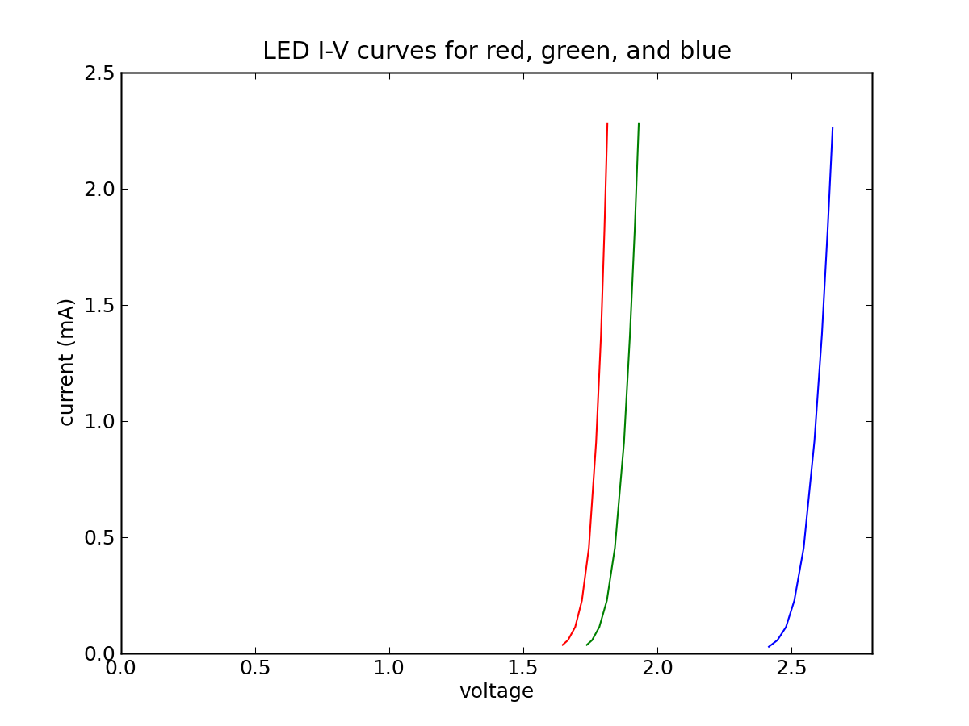
LED hookup
The output of Arduino digital I/O pins will be either 0 or 5 volts
An LED has a diode-like I-V curve
Can’t just put 5 V across
it’ll blow, unless current is limited
Put resistor in series, so ~2.5 V drop across each
250 Ω would mean 10 mA
10 mA is pretty bright

Slide 4
Blink Function (Subroutine)
For complex blink patterns, it pays to consolidate blink operation into a function
Now call with, e.g., blink(600,300)
Note function definition expects two integer arguments
LED is assumed to be global variable (defined outside of loop)
void blink(int ontime, int offtime)
{
// turns on LED (externally defined) for ontime ms
// then off for offtime ms before returning
digitalWrite(LED, HIGH);
delay(ontime);
digitalWrite(LED, LOW);
delay(offtime);
}

Slide 5
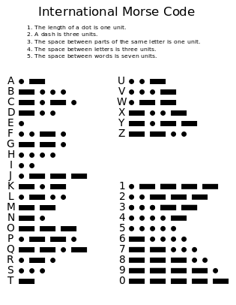
Blink Constructs
For something like Morse Code, could imagine building functions on functions, like
Note use of #define to specify duration of dot
and therefore overall cadence: change in one place!
#define DOTDUR 200
void dot() // dot, plus gap
{ blink(DOTDUR,DOTDUR); }
void dash() // dash, plus gap
{ blink(3*DOTDUR,DOTDUR); }
void letterspace() // aim for gap of 3
{ delay(2*DOTDUR); } // already have one
void wordspace() // aim for gap of 7
{ delay(4*DOTDUR); } // already have three

Slide 6
Morse, continued
And then perhaps letter functions:
You could then spell out a word pretty easily like:
Once you have a library of all the letters, it would be very simple to blink out anything you wanted
could even cleverly Morse-out string, like “HELLO”
void morse_s()
{ dot(); dot(); dot(); letterspace(); }
void morse_o()
{ dash(); dash(); dash(); letterspace(); }
morse_s();
morse_o();
morse_s();
wordspace();

Slide 7
Pulse Width Modulation
A “poor man’s” analog output can be synthesized out of a digital (0−5 V) signal by pulsing at variable duty cycle
the time average voltage can then be anything between 0 and 5 V
Arduino provides analogWrite(pin, value), valid for 6 of the 14 digital I/O pins on the Uno
value is a number from 0 to 255 (one byte)
For controlling LED brightness, the fraction of time in the ON state determines perceived brightness
For other applications, may want capacitor to average (smooth) out the frenzied pulse sequence

Slide 8
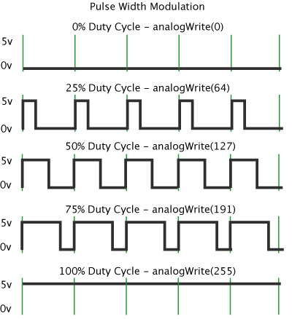
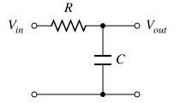
PWM, Visually
At right, pulse period denoted by green markers
Can go from always LOW (0% duty cycle) to always HIGH (100% duty cycle)
or anything in between, in 255 steps
Can change period, if needed
though only among limited selection of options
low pass filter can smooth out

Slide 9
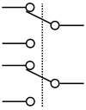
Switches & Debouncing
Switches come in a dizzying variety
normally open (NO), normally closed (NC)
applies to single throw, typically
single pole (SP), double pole (DP), etc.
how many inputs to the switch
single throw (ST), double throw (DT), etc.
how many contacts each input may make
DT can also come in CO variety: center open
The Arduino kit button is NO, SPST
it is normally open, one input (shared two pins), one output (shared two pins)
But switches are not as simple as you think
transition from open to closed can be erratic, random, fast oscillation, bouncing many times between states before settling
SPST
SPDT
DPST
DPDT
input side

Slide 10
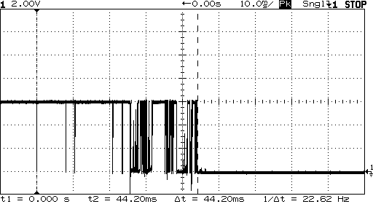
Typical Bounce
from softsolder.com
On the tens of milliseconds timescale, a switch can actually go through any number of transitions
Each time will look completely different
Idea is to catch first transition, then hold off until you’re sure things have settled out

Slide 11
Delay Can Save the Day
A fast microprocessor looking for switch transitions can catch all these bounces, as if you had pressed the button many times in fast succession
this is seldom the behavior we want
Inserting a delay gives the physical switch time to settle out
something like 50−100 ms is usually good; faster than you can intentionally press twice (see dt_pair)
Often use hardware solution too, with flip-flops
lock in first edge
Will also be relevant when we get to interrupts

Slide 12
Thinking Through Complex Logic
In the dimmer exercise, it’s tough to keep track of the states
Tendency to want to grasp entire scheme at once
Brains don’t often work that way
break it down to pieces you understand: divide & conquer
ask yourself questions throughout the process
Do I just need to know the state of the button, or catch change?
If catching a change, what am I comparing against?
Do I need a variable to keep track of a previous state?
If so, when do I store the “old” value?
If the button has just been pressed, what should I do?
Does the answer depend on the LED state?
Then do I need a variable to track this? (and the list goes on!)

Slide 13
Analog to Digital Conversion (ADC)
Computers are digital, while the physical world is analog
Converting voltage (analog value expressed electrically) into a digital number is a fundamental task in computer/world interface
Internally, the processor is doing a “guess and check” approach from most significant bit (MSB) to LSB
Arduino Uno has six analog inputs, turning each into a 10-bit number, 0..1023
measure 0−5 V range to 0.1%, or 5 mV precision
This is your key portal into using sensors

Slide 14
Assignments/Announcements
First week exercises due Tue/Wed, 1-11/12 by 2PM
depends on whether you are in Tue or Wed lab session
can drop in slot on TA room in back of MHA 3544
expect code printout (can be common to group), and some paragraphs from each group member as to contribution: how do we know you did something and learned?
TA office hours:
Clayton M 3-4 PM; Tu 1-2 PM
Paul F 2-3 PM; M 2-3 PM

